Slide 1
Hope Program Online Class on
Hope Program Class on “Relationships”
Lesson Outline of Topics
“Relationships”

Slide 2
God’s Design for Relationships
Lesson 1

Slide 3
You Were Made for Relationships
“Who are we?”
“How important are our relationships?”
“How do relationships affect me?”
“How can I have the kind of relationship God desires?”

Slide 4
The Bible says:
“It is not good for man to be alone;”
Genesis 2:18

Slide 5
God is Relational
Father
Holy
Spirit
Son

Slide 6
Genesis 1:26-27
“Let Us create man in Our image, according to Our likeness…”
“God created man in His own image, in the image of God He created them; male and female He created them.”

Slide 7
Man was created a triune being 1 Thessalonians 5:23 ; Hebrews 4:12
Spirit
Soul
Body

Slide 8
Why are Relationships Important?
God wants us to have a relationship with Him and with other people.
God wants us to grow; be productive and to mature in all aspects of our life.
God wants us to become like His Son.

Slide 9
Man has a Body, Soul and Spirit.
Body
Physical Faculties
(World Awareness)
Soul
Psychological Faculties
(Self Awareness)
Spirit
Spiritual Faculties
(God Awareness)

Slide 10
We have Three Sets of Faculties
Physical Faculties - We interact with the physical world through our body senses: seeing, feeling, hearing, smelling, tasting.
Psychological Faculties – personality, reasoning, mind, will, emotions, memory, making choices.
Spiritual Faculties - We interact with God through our spirit: conscience, prayer, worship, faith, hope, wisdom, discernment.

Slide 11
How Do Relationships Affect Me?

Slide 12
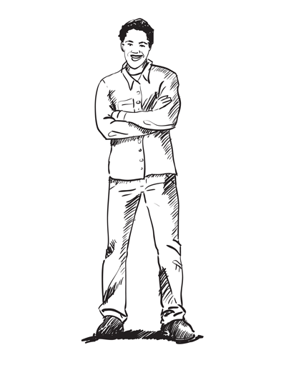
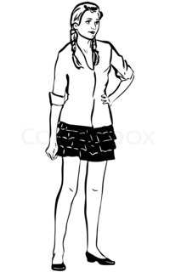
Bonds That Make A Right Relationship

Slide 13
Genesis 2:24
“For this reason a man shall leave his father and mother, and be joined to his wife; and the two shall become one flesh”

Slide 14
What’s Wrong With this Relationship?

Slide 15
Some Relationships Can be Out of Balance and Out of Order

Slide 16
A Wrong Relationship May Develop into an Incomplete Marriage

Slide 17
2 Corinthians 6:14-15
“ Do not be bound together with unbelievers; for what partnership have righteousness with lawlessness, or what fellowship has light with darkness?”
v15b “…..or what has a believer in common with an unbeliever?”

Slide 18
1 Thessalonians 4:3-5
“For this is the will of God, your sanctification; that is, that you abstain from sexual immorality;
that each of you know how to possess his own vessel in sanctification and honor,
not in lustful passion, like the Gentiles who do not know God…”

Slide 20
No Spiritual Bond – Little Hope for a Healthy Relationship

Slide 21
Bonds That Make A Right Relationship

Slide 22
How Can I Have the Kind of Relationship That God Desires?
Become “reborn” in your spirit by placing your faith and trust in Jesus Christ as your Savior.

Slide 23
John 3:16
"For God so loved the world, that He gave His only begotten Son, that whoever believes in Him shall not perish, but have eternal life.”

Slide 24
John 1:12
“But as many as received Him, to them He gave the right to become children of God, even to those who believe in His name,”

Slide 25
1 John 5:10-13
“And the testimony is this, that God has given us eternal life, and this life is in His Son. He who has the Son has the life; he who does not have the Son of God does not have the life.
These things I have written to you who believe in the name of the Son of God, so that you may know that you have eternal life. “

Slide 26
Romans 10:9-10
“…that if you confess with your mouth Jesus as Lord, and believe in your heart that God raised Him from the dead, you will be saved;
for with the heart a person believes, resulting in righteousness, and with the mouth he confesses, resulting in salvation. “

Slide 27
1 Peter 1:3-4
“Blessed be the God and Father of our Lord Jesus Christ, who according to His great mercy has caused us to be born again to a living hope through the resurrection of Jesus Christ from the dead,
to obtain an inheritance which is imperishable and undefiled and will not fade away, reserved in heaven for you…”

Slide 28
How Can I Have the Kind of Relationship That God Desires?
Become “reborn” in your spirit by placing your faith and trust in Jesus Christ as your Savior.
Begin to seek friendships with growing Christians.

Slide 29
2 Timothy 2:22
“Now flee from youthful lusts and pursue righteousness, faith, love and peace, with those who call on the Lord from a pure heart.”

Slide 30
How Can I Have the Kind of Relationship That God Desires?
Become “reborn” in your spirit by placing your faith and trust in Jesus Christ as your Savior.
Begin to seek friendships with growing Christians.
Find a church that teaches the Bible.

Slide 31
1 Peter 2:2
“like newborn babies, long for the pure milk of the word, so that by it you may grow in respect to salvation…”

Slide 32
The End of Lesson 1

