Slide 1

Hope Program Online Class on
Hope Program Class on “Relationships”
Lesson Outline of Topics
“Relationships”

Slide 2
Finding the Right Person
Lesson 3

Slide 3
What Does it Mean to “Find the Right Person”?
“The Love of Your Life”
“Soul Mate”
“Your Life Partner”
“That Special Someone”

Slide 4
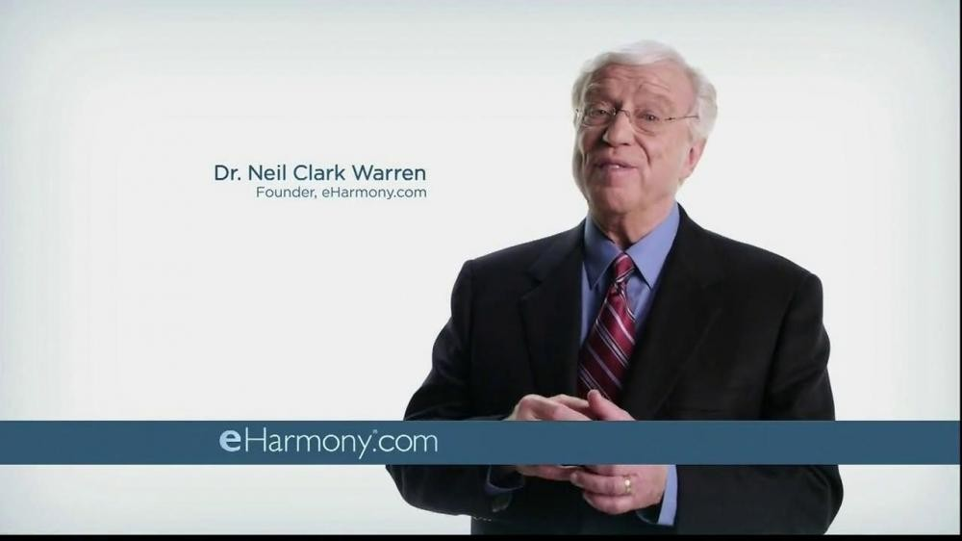
Finding the Love of Your Life

Slide 5

Finding the Love of Your Life

Slide 6

Finding the Love of Your Life

Slide 7
Finding the Right Person
Seeking to find our perfect complement…
Love is no fairy tale…
How do you set the foundation to attract this kind of love in your life?

Slide 8
Tips to Help You Find the Love of Your Life
Be Authentic...

Slide 9
Definition of Authentic
genuine, bona fide, true, legit, the real thing, the real McCoy, meaning being actually and exactly what is claimed.
authentic implies being fully trustworthy as according with fact.
true to one's own personality, spirit, or character is sincere and authentic with no pretensions

Slide 10
Be Authentic…
Emphasize your true self.
Be honest about your own failings.
People are attracted to authenticity.
Get to know yourself.
Learn to love yourself.
Shed all pretense.

Slide 11
Definition of Pretence
An attempt to make something that is not the case appear true.
Make-believe, putting on an act, acting, faking, posturing; deception, deceitfulness, fraud, trickery, dishonesty, hypocrisy, falsity, lying,

Slide 12
Tips to Help You Find the Love of Your Life
Be Authentic...
Be Content…

Slide 13
Be Content…
Don’t make your search for a relationship the center of your life.
Concentrate on activities you enjoy.
Focus on keeping yourself happy and content.

Slide 14
Tips to Help You Find the Love of Your Life
Be Authentic...
Be Content…
Be Friendly…

Slide 15
Be Friendly…
Be willing to connect and open up.
Be willing to engage in conversation.
Practice being friendly.
Learn to smile and look others in the eye.

Slide 16
Tips to Help You Find the Love of Your Life
Be Authentic...
Be Content…
Be Friendly…
Be Cautious…

Slide 17
Be Cautious…
First impressions aren’t always reliable.
It takes time to really get to know a person.
Experience being with someone in a variety of situations.

Slide 18
Tips to Help You Find the Love of Your Life
Be Authentic...
Be Content…
Be Friendly…
Be Cautious…
Be a Wise Investor…

Slide 19
Be a Wise Investor…
Be a wise investor of your heart.
Invest in a vertical relationship.
Take time to get to know the Lord first!
Consider carefully what kind of person God would want you to be with.

Slide 20
Psalm 37:3-5
Trust in the LORD and do good;
Dwell in the land and cultivate faithfulness.
Delight yourself in the LORD;
And He will give you the desires of your heart.
Commit your way to the LORD,
Trust also in Him, and He will do it.

Slide 21
Psalm 37:3-5
Trust in the LORD and do good;
Dwell in the land and cultivate faithfulness.
Delight yourself in the LORD;
And He will give you the desires of your heart.
Commit your way to the LORD,
Trust also in Him, and He will do it.

Slide 22
How to Know If You Have Found the Right Person?

Slide 23
How to Know If You Have Found the Right Person?
Trust in the Lord…(Proverbs 3:6-7)

Slide 24
Trust in the Lord
Trust in the LORD with all your heart And do not lean on your own understanding
In all your ways acknowledge Him, And He will make your paths straight.…
- Proverbs 3:6-7

Slide 25
How to Know If You Have Found the Right Person?
Trust in the Lord…(Proverbs 3:6-7)
Be Patient… (Hebrews 10:35-36)

Slide 26
Be Patient
Therefore, do not throw away your confidence, which has a great reward. Patient endurance is what you need now, so that you will continue to do God's will. Then you will receive all that He has promised. Hebrews 10:35-36

Slide 27
How to Know If You Have Found the Right Person?
Trust in the Lord…(Proverbs 3:6-7)
Be Patient… (Hebrews 10:35-36)
Ask God for Wisdom… (James 1:5)

Slide 28
Ask God for Wisdom
If any of you lacks wisdom, let him ask God, who gives generously to all without reproach, and it will be given him.
James 1:5

Slide 29
How to Know If You Have Found the Right Person?
Trust in the Lord…(Proverbs 3:6-7)
Be Patient… (Hebrews 10:35-36)
Ask God for Wisdom… (James 1:5)
Ask God to Remove Doubts… (Phil. 4:6-7)

Slide 30
Ask God to Remove Doubts
Be anxious for nothing, but in everything by prayer and supplication with thanksgiving let your requests be made known to God. And the peace of God, which surpasses all understanding, will guard your hearts and your minds in Christ Jesus.…
Philippians 4:6-7

Slide 31
How to Know If You Have Found the Right Person?
Trust in the Lord…(Proverbs 3:6-7)
Be Patient… (Hebrews 10:35-36)
Ask God for Wisdom… (James 1:5)
Ask God to Remove Doubts… (Phil. 4:6-7)

Slide 32
How Can I Be that Right Person?
He who pursues righteousness and unfailing love, will find life, righteousness and honor. - Proverbs 21:21
There is a way that appears to be right, but in the end it leads to death. - Proverbs 14:12
For God made Christ, who never sinned, to be the offering for our sin, so that we could be made right with God through Christ. - 2 Corinthians 5:21

Slide 33
How Can I Be that Right Person?
Yet we know that a person is made right with God by faith in Jesus Christ, not by obeying the law. And we have believed in Christ Jesus, so that we might be made right with God because of our faith in Christ, - Galatians 2:16
For by grace you have been saved through faith; and that not of yourselves, it is the gift of God; - Ephesians 2:8
But blessed is the one who trusts in the LORD, whose confidence is in Him. - Jeremiah 17:7

Slide 34
End of Lesson
3

